Slide 1
NETWORKING II
Lecturer: Dr. Martin Kuradusenge

Slide 2
COURSE OUTLINES
Chapter 1: Introduction to Routing and Packet Forwarding
Chapter 2: Static Routing
Chapter 3: Introduction to Dynamic Routing Protocol
Chapter 4: VLSM and Classless Inter-Domain Routing (CIDR)
Chapter 5: Distance Vector Routing Protocols (RIPv1 and RIP v2)
Chapter 6: Enhanced Interior Gateway Routing Protocol (EIGRP).
Chapter 7: Link-State Routing Protocols, OSPF
Chapter 8: Access-control lists
Chapter 9: DHCP
Chapter 10: NAT

Slide 3
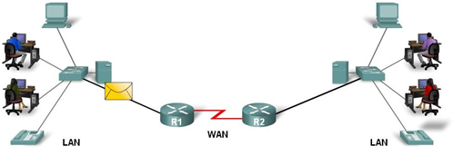
Introduction to routing and packet forwarding
Routers are computers that specialize in sending packets over the data network. They are responsible for interconnecting networks by selecting the best path for a packet to travel and forwarding packets to their destination.
The general role of the router is to choose the best path and forwarding packets to destination
Routers generally have 2 connections WAN connection (Connection to ISP) and LAN connection. Data is sent in form of packets between 2 ends devices.
Routers are used to direct packet to its destination

Slide 4
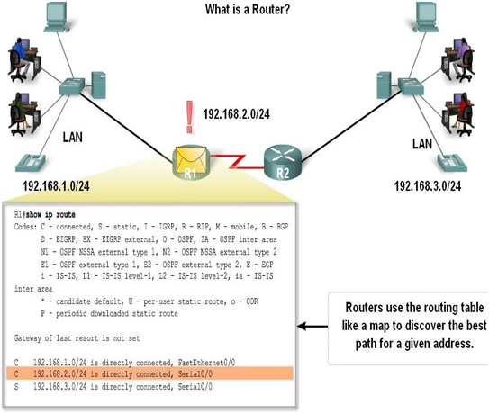
Router

Slide 5
Router components and their functions
A router has many components, there are:
CPU - Executes operating system instructions
Random access memory (RAM) - Contains the running copy of configuration file. Stores routing table. RAM contents lost when power is off
Read-only memory (ROM) - Holds diagnostic software used when router is powered up. Stores the router’s bootstrap program.
Non-volatile RAM (NVRAM) - Stores startup configuration. This may include IP addresses (Routing protocol, Hostname of router)
Flash memory - Contains the operating system (Cisco IOS)
Interfaces - There exist multiple physical interfaces that are used to connect network. Such as Ethernet / fast Ethernet interfaces, Serial interfaces and Management interfaces.

Slide 6
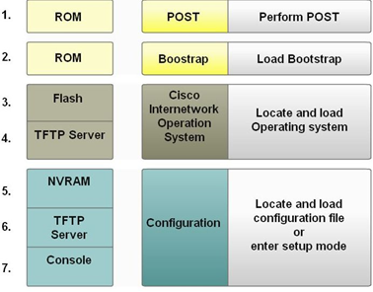
Major phases to the router boot-up process
When a router boots up, it goes through 4 main steps:
Test router hardware consists of performing Power-On Self Test (POST).
Execute bootstrap loader
Locate & load Cisco IOS software consists of locating and loading IOS
Locate & load startup configuration file or enter setup mode

Slide 7
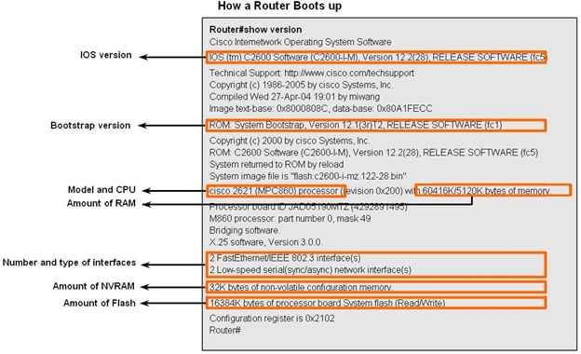
How router boots up
The show version command is used to view information about the router during the boot up process.
That information includes: Platform model number, Image name & IOS version, Bootstrap version stored in ROM, Image file name & where it was loaded from, Number & type of interfaces, Amount of NVRAM, Amount of flash and Configuration register

Slide 8
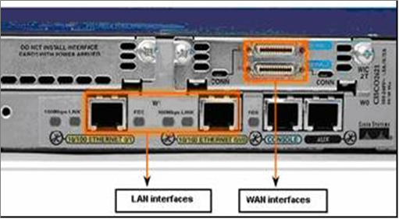
Router Interface

Slide 9
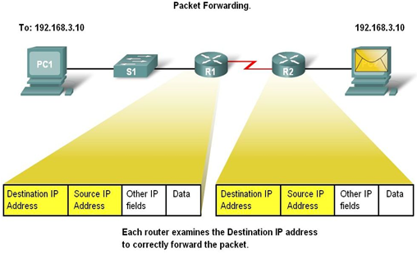
Routers and the Network Layer

Slide 10
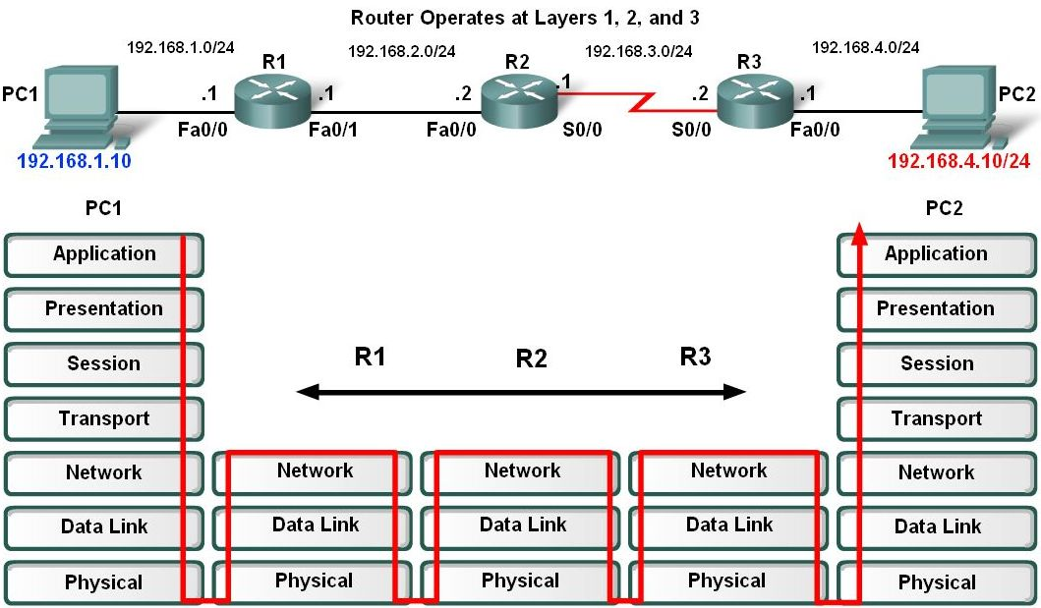

Slide 11
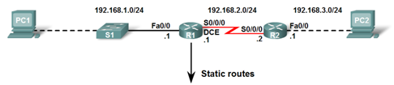
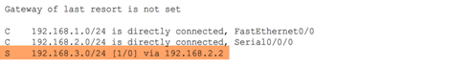
Routing Table Structure

Slide 12
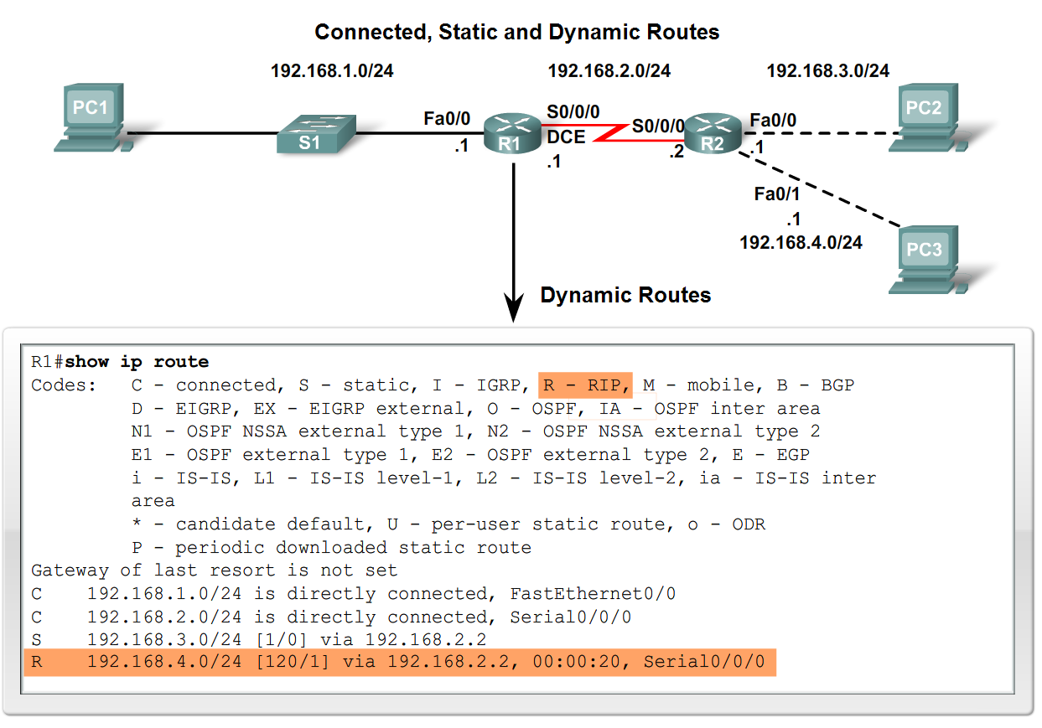

Slide 13
Routing Table Principles
There are 3 principles regarding routing tables:
Every router makes its decisions alone, based on the information it has in its routing table.
Different routing table may contain different information
A routing table can tell how to get to a destination but not how to get back

Slide 14
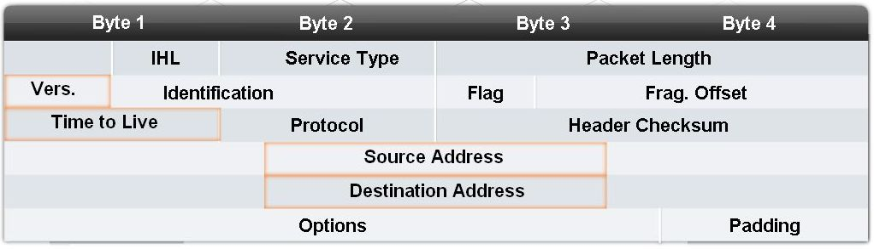
Packet format
Internet Protocol (IP) packet format contains fields that provide information about the packet and the sending and receiving hosts. Fields that are importance for CCNA students are destination IP address, source IP address, version & TTL, IP header length, precedence & type of service and Packet length.

Slide 15
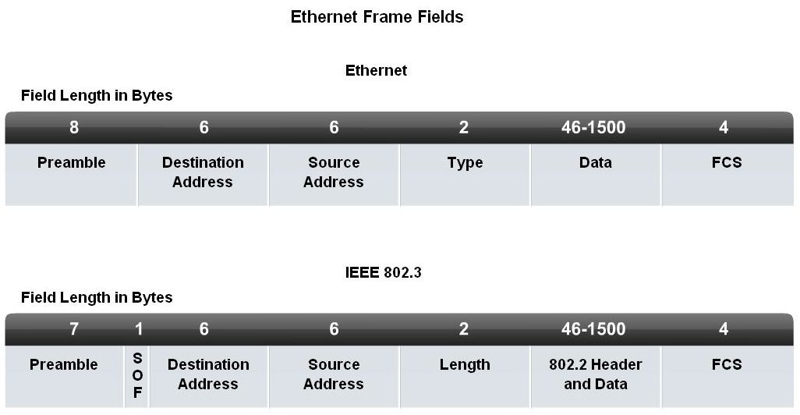
Ethernet frame

Slide 16
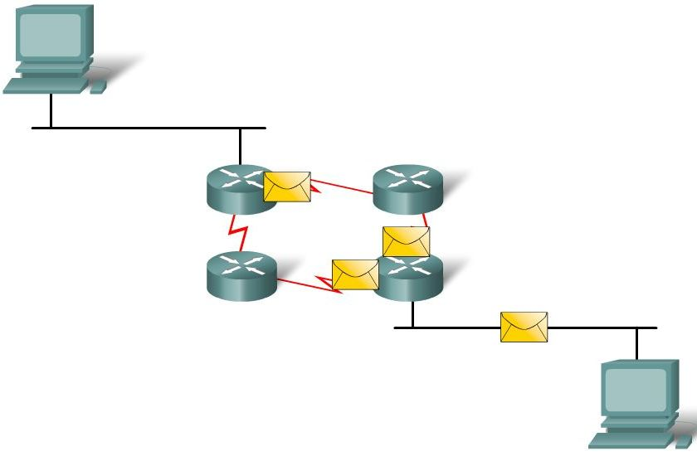
Equal cost metric
It is a condition where a router has multiple paths to the same destination that all have the same metric. To solve this dilemma, a router will use Equal Cost Load Balancing. This means the router sends packets over the multiple exit interfaces listed in the routing table.

Slide 17
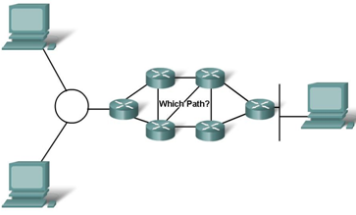
Path determination
Switching Function of Router is the process used by a router to switch a packet from an incoming interface to an outgoing interface on the same router.
A packet received by a router will do the following:
Strips off layer 2 headers.
Examines destination IP address located in Layer 3 header to find best route to destination.
Re-encapsulates layer 3 packet into layer 2 frame.
Forwards frame out exit interface.
Note: As a packet travels from one networking device to another the source and destination IP addresses NEVER change while the source & destination MAC addresses CHANGE as packet is forwarded from one router to the next.

Slide 18
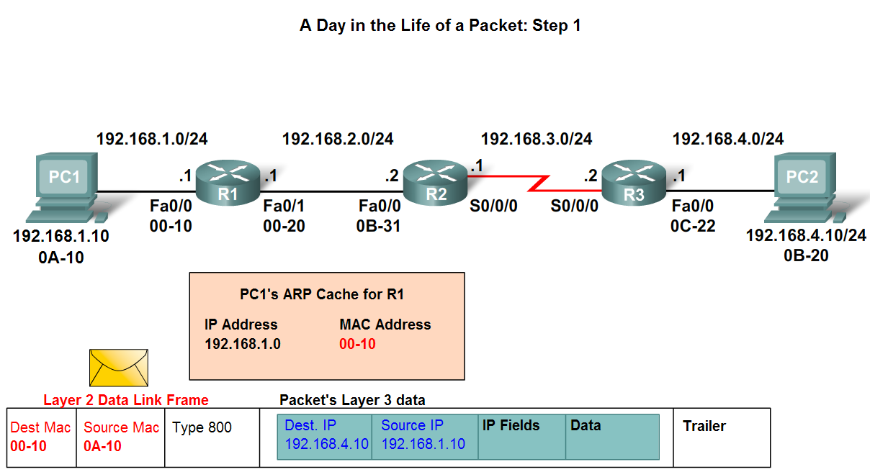
Step 1: PC1 encapsulates packet into a frame. Frame contains R1’s destination MAC address
Step 2: R1 receives Ethernet frame.
- R1 sees that destination MAC address matches its own MAC.
- R1 then strips off Ethernet frame.
- R1 Examines destination IP.
- R1 consults routing table looking for destination IP.
- After finding destination IP in routing table, R1 now looks up next hop IP address.
- R1 re-encapsulates IP packet with a new Ethernet frame.
- R1 forwards Ethernet packet out Fa0/1 interface.

Slide 19
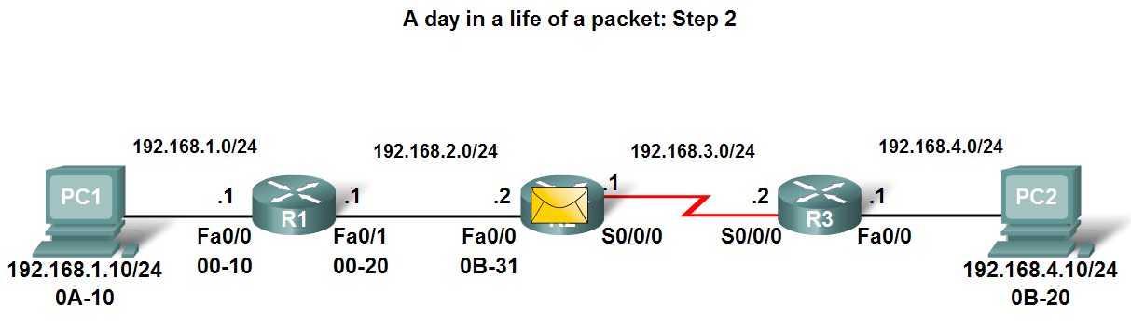
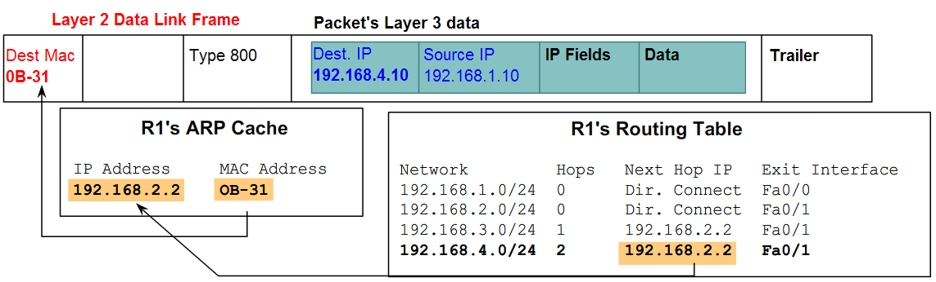

Slide 20
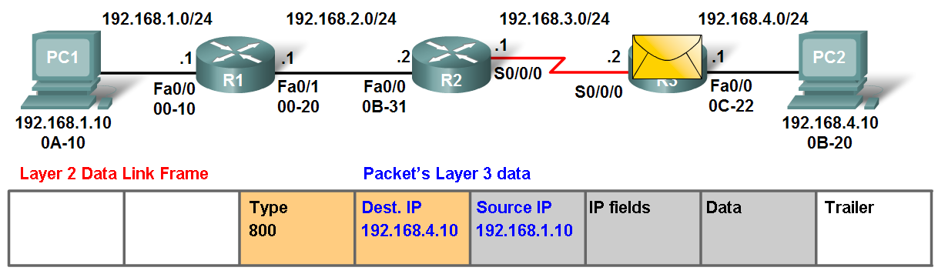
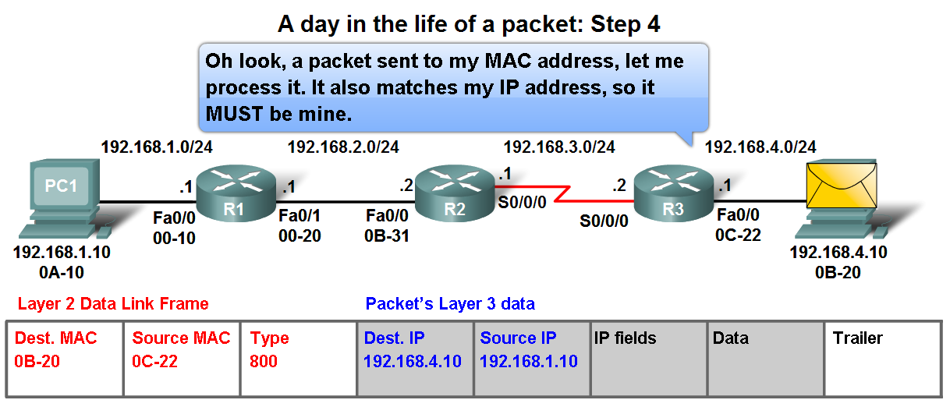

Slide 21
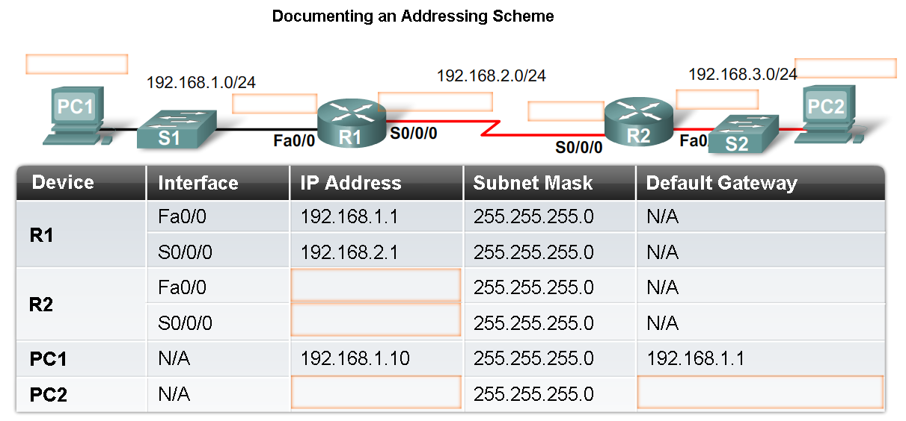

Slide 22
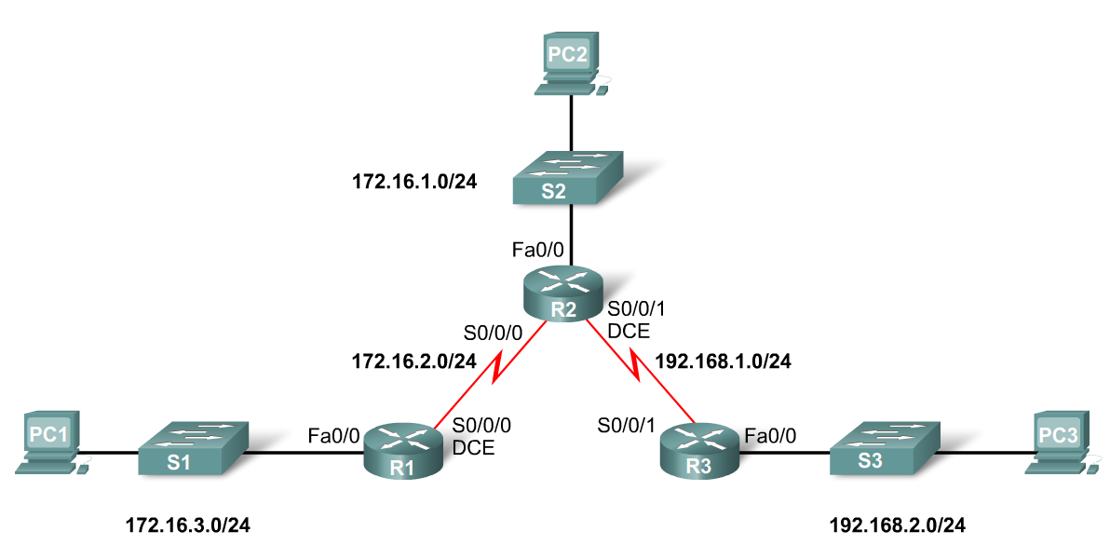
STATIC ROUTING

Slide 23
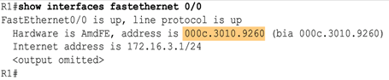
Verifying Ethernet interface

Slide 24
NETWORKING II
Lecture 2

Slide 25
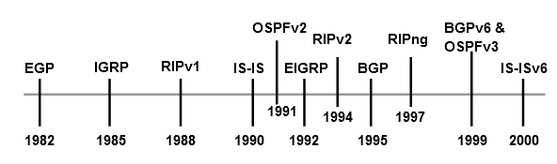
Introduction to Dynamic Routing Protocol
Dynamic routing protocols are usually used in larger networks to ease the administrative and operational overhead of using only static routes.
The following is the evolution of routing protocols

Slide 26
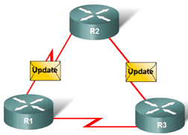
The functions of Dynamic Routing Protocols
Routing protocols are used to facilitate the exchange of routing information between routers.
Routing protocols allow routers to dynamically share information about remote networks and automatically add this information to their own routing tables and determine best path to a destination.
A routing protocol is a set of processes, algorithms, and messages that are used to exchange routing information and populate the routing table with the routing protocol's choice of best paths. The purpose of a routing protocol includes:
Discovery of remote networks
Maintaining up-to-date routing information
Choosing the best path to destination networks
Ability to find a new best path if the current is no longer available.

Slide 27
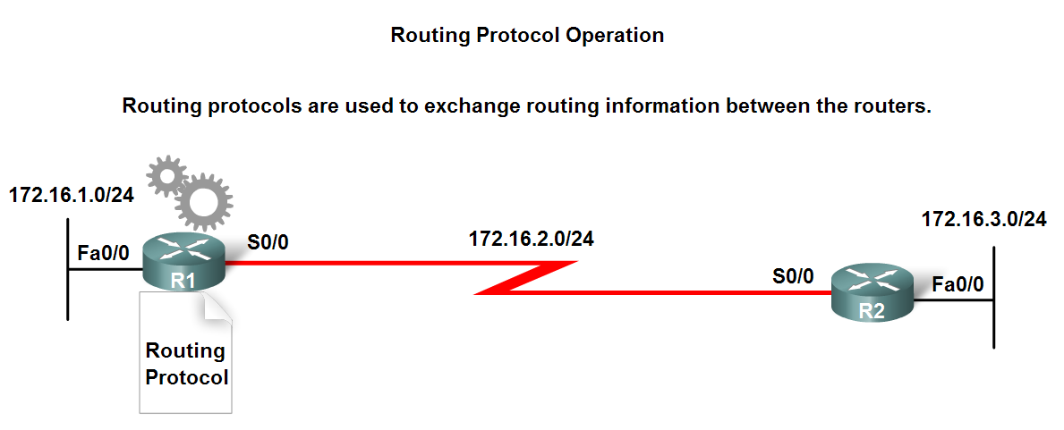

Slide 28
Classifying Routing Protocols
-Interior Gateway Protocols (IGP): Used for routing inside an autonomous system & used to route within the individual networks themselves. Examples: RIP, EIGRP, OSPF
-Exterior Gateway Protocols (EGP) -Used for routing between autonomous systems. Example: BGPv4
An autonomous system (AS) known as a routing domain is a collection of routers under a common administration. Typical examples are a company's internal network and an Internet service provider's network.

Slide 29
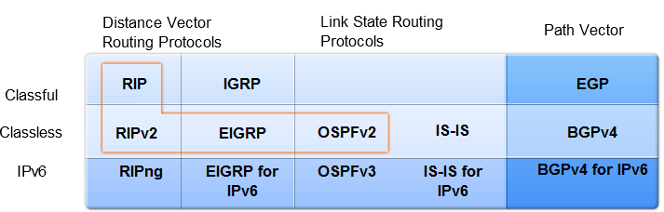
Classifying Routing Protocols (cont’d)

Slide 30
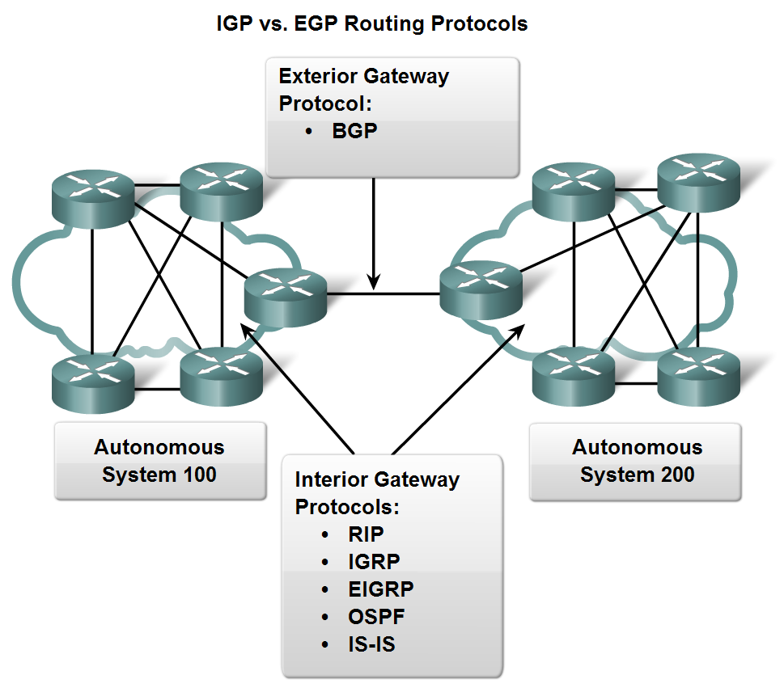

Slide 31
Interior Gateway Protocol
Interior Gateway Protocols (IGPs) can be classified as two types:
Distance vector routing protocols
Link-state routing protocols

Slide 32
Distance vector
Distance vector means that routes are advertised as vectors of distance and direction. Distance is defined in terms of a metric such as hop count and direction is simply the next-hop router or exit interface. Distance vector protocols typically use the Bellman-Ford algorithm for the best path route determination.
Some distance vector protocols periodically send complete routing tables to all connected neighbors. In large networks, these routing updates can become enormous, causing significant traffic on the links. The algorithm does not allow a router to know the exact topology of an internetwork. The router only knows the routing information received from its neighbors.
Distance vector protocols work best in situations where:
The network is simple and flat and does not require a special hierarchical design.
The administrators do not have enough knowledge to configure and troubleshoot link-state protocols.
Worst-case convergence times in a network are not a concern.

Slide 33
Link state
In contrast to distance vector routing protocol operation, a router configured with a link-state routing protocol can create a "complete view" or topology of the network by gathering information from all of the other routers.
Link-state routing protocols do not use periodic updates. After the network has converged, a link-state update only sent when there is a change in the topology.
Link-state protocols work best in situations where:
The network design is hierarchical, usually occurring in large networks.
The administrators have a good knowledge of the implemented link-state routing protocol.
Fast convergence of the network is crucial.

Slide 34
Classful routing protocols
A routing protocol did not need to include the subnet mask in the routing update because the network mask could be determined based on the first octet of the network address.
Classful routing protocols cannot be used when a network is subnetted using more than one subnet mask.
Classful do NOT send subnet mask in routing updates. Classful routing protocols include RIPv1 and IGRP.

Slide 35
Classless routing protocols
Classless routing protocols include the subnet mask with the network address in routing updates.
Classless routing protocols are required in most networks today because of their support for VLSM, discontiguous networks and other features. Do send subnet mask in routing updates.
Classless routing protocols are RIPv2, EIGRP, OSPF, IS-IS, BGP.

Slide 36
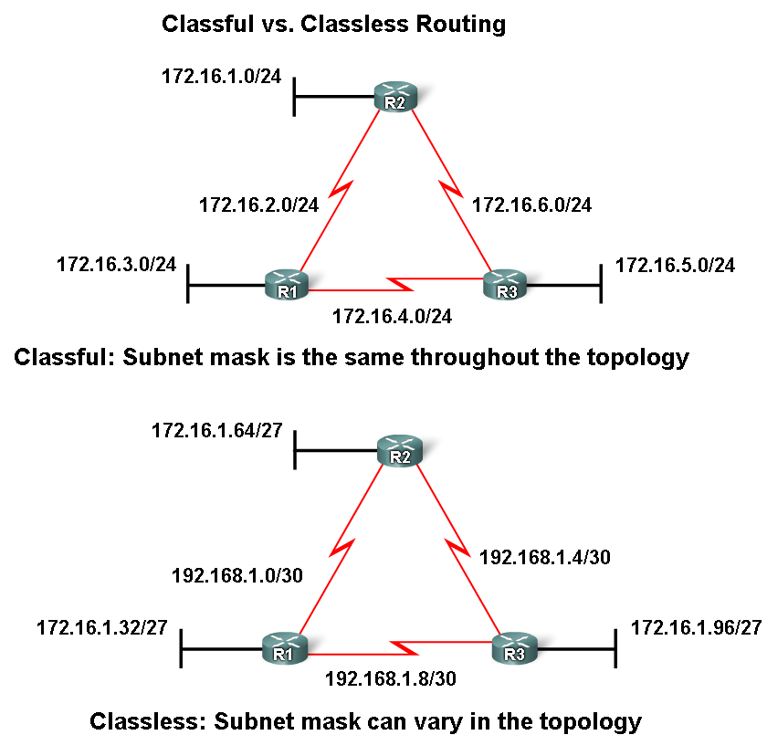

Slide 37
Convergence
Convergence is when all routers' routing tables are at a state of consistency.
The network has converged when all routers have complete and accurate information about the network. Convergence time is the time it takes routers to share information, calculate best paths, and update their routing tables.
A network is not completely operable until the network has converged; therefore, most networks require short convergence times.

Slide 38
Routing Protocols Metrics
A metric is a value used by routing protocols to assign costs to reach remote networks. The metric is used to determine which path is most preferable when there are multiple paths to the same remote network.
The purpose of a metric is to calculated value used to determine the best path to a destination. Each routing protocol uses its own metric.
For example, RIP uses hop count, EIGRP uses a combination of bandwidth and delay, and Cisco's implementation of OSPF uses bandwidth.

Slide 39
Metrics used in IP routing protocols
Hop count - A simple metric that counts the number of routers a packet must traverse.
Bandwidth - Influences path selection by preferring the path with the highest bandwidth
Load - Considers the traffic utilization of a certain link
Delay - Considers the time a packet takes to traverse a path
Reliability - Assesses the probability of a link failure, calculated from the interface error count or previous link failures
Cost - A value determined either by the IOS or by the network administrator to indicate preference for a route. Cost can represent a metric, a combination of metrics or a policy.

Slide 40
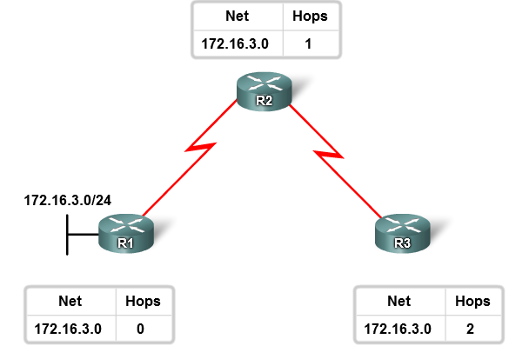

Slide 41
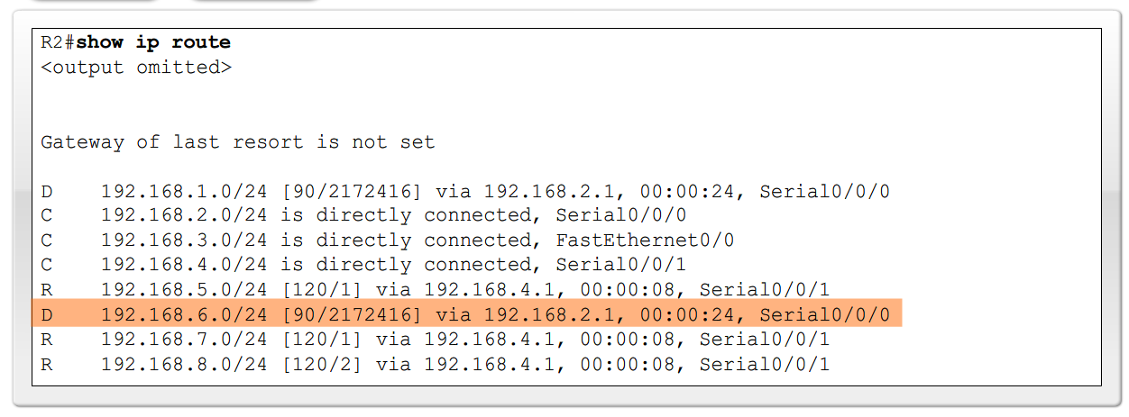
Administrative Distance of a Route
Administrative Distance is a numeric value that specifies the preference of a particular route.
Cisco routers use the AD feature to select the best path when it learns about the same destination network from two or more different routing sources.
Administrative distance is an integer value from 0 to 255. The lower the value the more preferred the route source. An administrative distance of 0 is the most preferred. Only a directly connected network has an administrative distance of 0, which cannot be changed.
The Administrative Distance (AD) in a routing table is the first number in the brackets in the routing table.

Slide 42
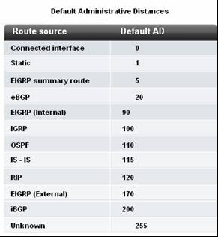
Dynamic Routing Protocols AD

Slide 43
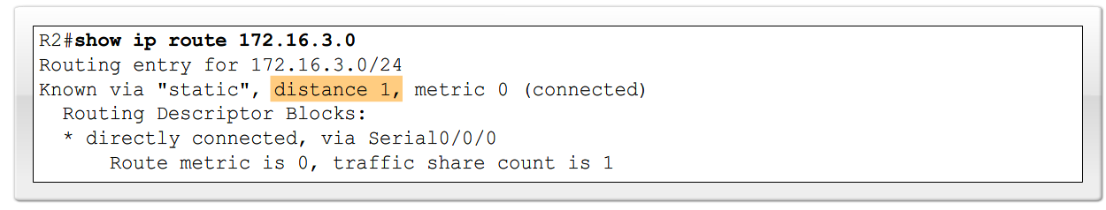
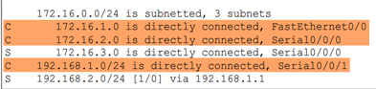
Directly connected routes have a default AD of 0

Slide 44
Variable Length Subnet Mask (VLSM) and Classless Inter Domain Routing (CIDR)
Prior to 1981, IP addresses used only the first 8 bits to specify the network portion of the address
In 1981, RFC 791 modified the IPv4 32-bit address to allow for three different classes.
IP address space was depleting rapidly, the Internet Engineering Task Force (IETF) introduced Classless Inter-Domain Routing (CIDR). CIDR uses Variable Length Subnet Masking (VLSM) to help conserve address space. VLSM is the process of sub-netting a subnet to fit your needs.

Slide 45
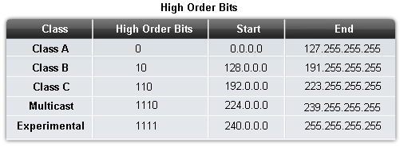
The High Order Bits

Slide 46
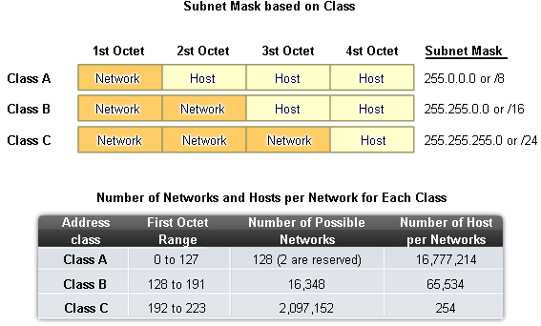

Slide 47
Classless Inter-domain Routing (CIDR)
In 1993, IETF (Internet Engineering Task Force) introduced Classless Inter-Domain Routing, or CIDR.
CIDR allowed for more efficient use of IPv4 address space and prefix aggregation, which reduced the size of routing tables (with route summarization).
Classless requires subnet mask to be included in routing update because address class is meaningless.

Slide 48
Classless IP Addressing
CIDR uses Variable Length Subnet Masks (VLSM) to allocate IP addresses to subnets according to individual need rather than by class.
This type of allocation allows the network/host boundary to occur at any bit in the address.
Networks can be further divided or subnetted into smaller and smaller subnets.

Slide 49
CIDR & Route Summarization
Variable Length Subnet Masking (VLSM)
Allows a subnet to be further sub-netted according to individual needs
Prefix Aggregation a.k.a. Route Summarization
CIDR allows for routes to be summarized as a single route.
Characteristics of classless routing protocols are:
- Routing updates include the subnet mask
- Supports VLSM
- Supports Route Summarization

Slide 50
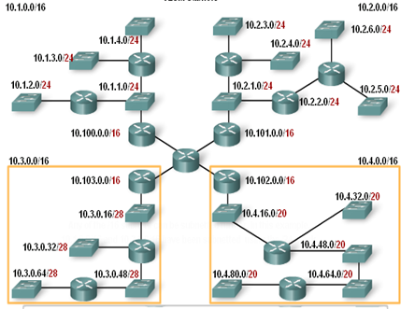

Slide 51
NETWORKING II
LECTURE 3

Slide 52
Distance Vector Routing Protocols (RIPv1 and RIP v2)
Dynamic routing protocols help the network administrator overcome the time-consuming and exacting process of configuring and maintaining static routes.
Distance vector routing protocols include RIP, IGRP, and EIGRP
Routing Information Protocol (RIP) has the following key characteristics:
Hop count is used as the metric for path selection.
If the hop count for a network is greater than 15, RIP cannot supply a route to that network.
Routing updates are broadcast or multicast every 30 seconds, by default.

Slide 53
Interior Gateway Routing Protocol (IGRP)
IGRP is a proprietary protocol developed by Cisco.
IGRP has the following key design characteristics:
Bandwidth, delay, load and reliability are used to create a composite metric.
Routing updates are broadcast every 90 seconds, by default.
IGRP is the predecessor of EIGRP and is now obsolete.

Slide 54
EIGRP
Enhanced IGRP (EIGRP) is a Cisco proprietary distance vector routing protocol.
EIGRP has these key characteristics:
It can perform unequal cost load balancing.
It uses Diffusing Update Algorithm (DUAL) to calculate the shortest path.
There are no periodic updates as with RIP and IGRP. Routing updates are sent only when there is a change in the topology.
A router using a distance vector routing protocol does not have the knowledge of the entire path to a destination network. Instead the router knows only:
The direction or interface in which packets should be forwarded and
The distance or how far it is to the destination network

Slide 55
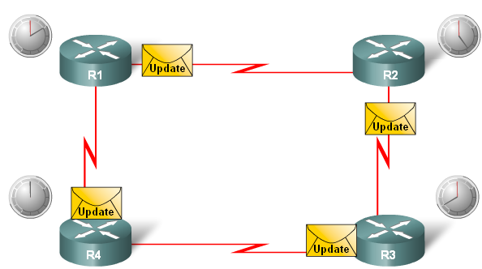
Characteristics of Distance Vector routing protocols:
Periodic updates are sent at regular intervals (30 seconds for RIP and 90 seconds for IGRP). Even if the topology has not changed in several days, periodic updates continue to be sent to all neighbors.
Neighbors are routers that share a link and are configured to use the same routing protocol.
Broadcast updates are sent to 255.255.255.255. Neighboring routers that are configured with the same routing protocol will process the updates. Entire routing table is included with routing update.
Note: Some distance vector routing protocols like EIGRP do not send periodic routing table updates.

Slide 56
Routing Protocol Algorithm
At the core of the distance vector protocol is the algorithm. The algorithm is used to calculate the best paths and then send that information to the neighbors.
An algorithm is a procedure for accomplishing a certain task, starting at a given initial state and terminating in a defined end state.
Different routing protocols use different algorithms to install routes in the routing table, send updates to neighbors, and make path determination decisions.
The algorithm used for the routing protocols defines the following processes:
Mechanism for sending and receiving routing information.
Mechanism for calculating the best paths and installing routes in the routing table.
Mechanism for detecting and reacting to topology changes.

Slide 57
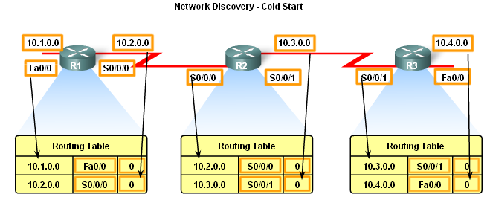
Network Discovery
When a router cold starts or powers up, it knows nothing about the network topology. It does not even know that there are devices on the other end of its links.
If a routing protocol is configured, the routers begin exchanging routing updates. Initially, these updates only include information about their directly connected networks.
Upon receiving an update, the router checks it for new information. Any routes that are not currently in its routing table are added.

Slide 58
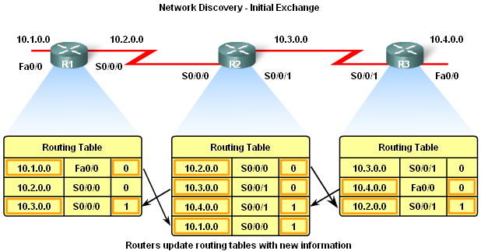
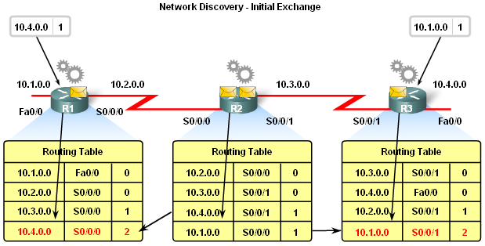

Slide 59
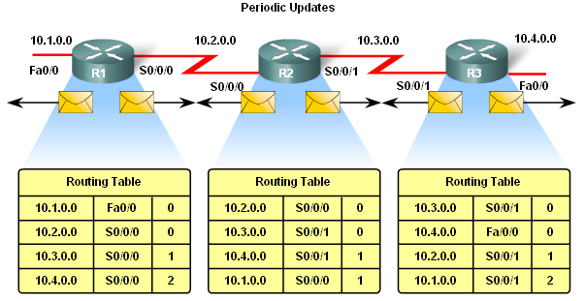
Convergence
Convergence must be reached before a network is considered completely operable
Speed of achieving convergence consists of 2 interdependent categories: Speed of broadcasting routing information and Speed of calculating routes.
These are time intervals in which a router sends out its entire routing table.

Slide 60
Triggered Updates
To speed up the convergence when there is a topology change, RIP uses triggered updates. A triggered update is a routing table update that is sent immediately in response to a routing change. Triggered updates do not wait for update timers to expire.
The detecting router immediately sends an update message to adjacent routers. The receiving routers, in turn, generate triggered updates that notify their neighbors of the change.
Triggered updates are sent when one of the following occurs:
An interface changes state (up or down)
A route has entered (or exited) the "unreachable" state
A route is installed in the routing table

Slide 61
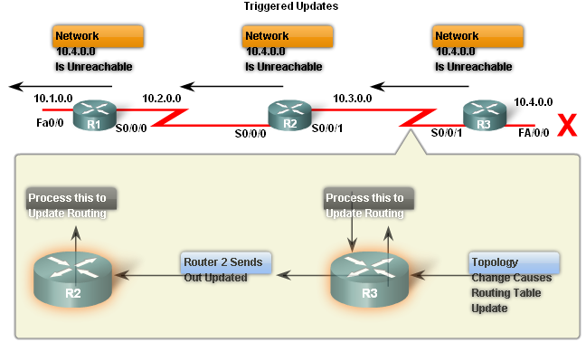

Slide 62
Routing Information Protocol (RIP)
RIPv1 is a classful, Distance Vector (DV) routing protocol, its metric is hop count, a route with a hop count great that 15(> 15) is unreachable and updates are broadcast every 30 seconds.

Slide 63
RIP Operation
RIP uses 2 message types:
Request message -This is sent out on startup by each RIP enabled interface and requests all RIP enabled neighbors to send routing table.
Response message -Message sent to requesting router containing routing table
RIP is a classful routing protocol; does not send subnet masks in routing updates. RIP’s default administrative distance is 120.

Slide 64
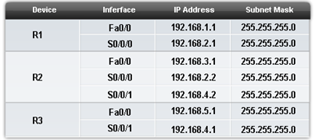
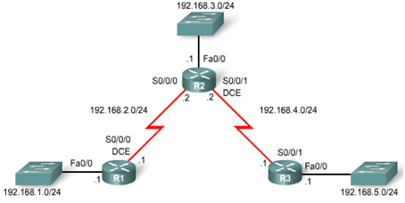
Basic RIPv1 Configuration

Slide 65
ENHANCED INTERIOR GATEWAY ROUTING PROTOCOL (EIGRP)
The main purpose in Cisco's development of EIGRP was to create a classless version of IGRP.
EIGRP includes several features that are not commonly found in other distance vector routing protocols like RIP (RIPv1 and RIPv2) and IGRP. These features include:
Reliable Transport Protocol (RTP), Bounded Updates, Diffusing Update Algorithm (DUAL), Establishing Adjacencies and Neighbor and Topology Tables:
Metrics used by IGRP are bandwidth (used by default), Delay (used by default), Reliability and load.

Slide 66
EIGRP’s 5 Packet Types
Hello packets are used to discover & form adjacencies with neighbors
Unreliable so no response required from recipient
Update packets are used to propagate routing information
Acknowledgement packets are used to acknowledge receipt of update, query & reply packets
Query & Reply packets are used by DUAL for searching for networks. Query packets can use unicast and multicast and reply packet can use only unicast.

Slide 67
Diffusing Update Algorithm (DUAL)
Diffusing Update Algorithm (DUAL) is the convergence algorithm used by EIGRP instead of the Bellman-Ford or Ford Fulkerson algorithms used by other distance vector routing protocols, like RIP.
The primary way that EIGRP prevents routing loops is with the DUAL algorithm. This allows all routers involved in a topology change to synchronize at the same time.
Routers that are not affected by the topology changes are not involved in the recomputation. This method provides EIGRP with faster convergence times than other distance vector routing protocols.

Slide 68
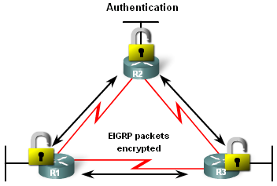
Authentication
Like other routing protocols, EIGRP can be configured for authentication. RIPv2, EIGRP, OSPF, IS-IS, and BGP can all be configured to encrypt and authenticate their routing information.
It is good practice to authenticate transmitted routing information. This practice ensures that routers will only accept routing information from other routers that have been configured with the same password or authentication information.
EIGRP can encrypt routing information and authenticate routing information.

Slide 69
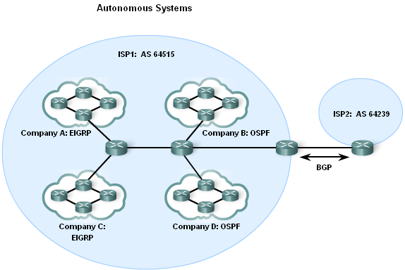
Entities needing AS numbers are ISP, Internet Backbone providers and institutions connecting to other institutions using AS numbers.
All routers in the EIGRP routing domain must use the same process ID number (autonomous-system number).

Slide 70
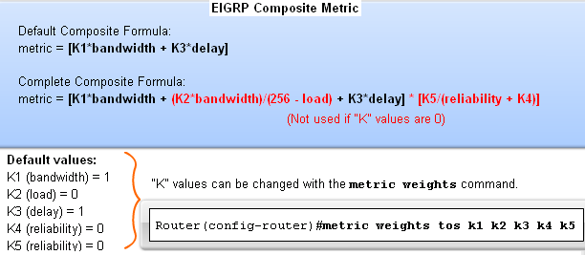
EIGRP Metric Calculation
EIGRP uses the following values in its composite metric: Bandwidth, delay, reliability, and load
The composite metric used by EIGRP formula has values K1 àK5, where K1 & K3=1 and all other K values = 0
Use the sh ip protocols command to verify the K values

Slide 71
EIGRP Metrics
Bandwidth – EIGRP uses a static bandwidth to calculate metric, Most serial interfaces use a default bandwidth value of 1.544Mbos (T1). Use the show interfaces command to view metrics.
Delay is the defined as the measure of time it takes for a packet to traverse a route, it is a static value based on link type to which interface is connected.
Reliability (not a default EIGRP metric): A measure of the likelihood that a link will fail. Measure dynamically & expressed as a fraction of 255 the higher the fraction the better the reliability.
Load (not a default EIGRP metric).
A number that reflects how much traffic is using a link. Number is determined dynamically and is expressed as a fraction of 255; the lower the fraction the less the load on the link.

Slide 72
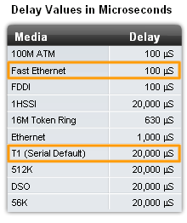

Slide 73
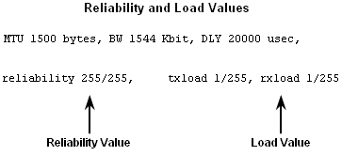

Slide 74
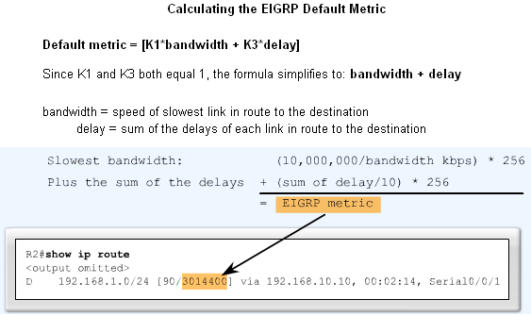

Slide 75
DUAL Concepts
The Diffusing Update Algorithm (DUAL) is used to prevent looping, to allow loop free paths, loop free backup paths, fast convergence and minimum bandwidth usage with bounded updates.
DUAL uses several terms, these terms and concepts are at the center of DUAL's loop avoidance mechanism:
Successor: A successor is a neighboring router that is used for packet forwarding and is the least-cost route to the destination network. The IP address of a successor is shown in a routing table entry right after the word via.
Feasible distance (FD): Feasible distance is the lowest calculated metric to reach the destination network. FD is the metric listed in the routing table entry as the second number inside the brackets. As with other routing protocols this is also known as the metric for the route.

Slide 76
Feasible Successors, Feasibility Condition & Reported Distance
One of the reasons DUAL can converge quickly after a change in the topology is because it can use backup paths to other routers known as feasible successors without having to recompute DUAL.
The feasibility condition (FC) is met when a neighbor's reported distance (RD) to a network is less than the local router's feasible distance to the same destination network.
The reported distance or advertised distance is simply an EIGRP neighbor's feasible distance to the same destination network.
The reported distance is the metric that a router reports to a neighbor about its own cost to that network.

Slide 77
Reported distance (RD)
Reported distance is the metric that a router reports to a neighbor about its own cost to that network.
- Feasibility Condition (FC) is met when a neighbor’s RD is less than the local router’s FD to the same destination network.
EIGRP Topology table is viewed using the show ip eigrp topology command.

Slide 78


Slide 79


Slide 80
NETWORKING II
LECTURE 4

Slide 81
Link-State Routing Protocols, OSPF
Distance vector routing protocols are like road signs because routers must make preferred path decisions based on a distance or metric to a network.
Link-state routing protocols take a different approach. Link-state routing protocols are more like a road map because they create a topological map of the network and each router uses this map to determine the shortest path to each network.
Link-state routing protocols are also known as shortest path first protocols and built around Edsger Dijkstra's shortest path first (SPF) algorithm.

Slide 82



Slide 83
Link-State Routing Process
All routers in our topology will complete the following generic link-state routing process to reach a state of convergence:
Each routers learns about its own directly connected networks
Link state routers exchange hello packet to “meet” other directly connected link state routers.
Each router builds its own Link State Packet (LSP) which includes information about neighbors such as neighbor ID, link type, & bandwidth.
After the LSP is created the router floods it to all neighbors who then store the information and then forward it until all routers have the same information.
Once all the routers have received all the LSPs, the routers then construct a topological map of the network which is used to determine the best routes to a destination.

Slide 84


Slide 85


Slide 86



Slide 87



Slide 88

- LSPs are sent out under the following conditions
-Initial router start up or routing process
-When there is a change in topology

Slide 89


Slide 90




Constructing a link state database
Routers use a database to construct a topology map of the network.

Slide 91


Slide 92
Requirements for using a link state routing protocol
Memory requirements: Link state requires more memory, more CPU processing, and at times more bandwidth than distance vector routing protocols. The memory requirements are due to the use of link-state databases and the creation of the SPF tree.
Processing Requirements: More CPU processing is required of link state routing protocols. The SPF algorithm requires more CPU time than distance vector algorithms such as Bellman-Ford because link-state protocols build a complete map of the topology.
Bandwidth Requirements: Initial startup of link state routing protocols can consume lots of bandwidth

Slide 93


Slide 94

OSPF Algorithm
Each OSPF router maintains a link-state database containing the LSAs received from all other routers.
Once a router has received all of LSAs and built its local link-state database, OSPF uses Dijkstra's shortest path first (SPF) algorithm to create an SPF tree.
The SPF tree is then used to populate the IP routing table with the best paths to each network.

Slide 95


OSPF Authentication
Purpose is to encrypt & authenticate routing information
This is an interface specific configuration
Routers will only accept routing information from other routers that have been configured with the same password or authentication information

Slide 96




Slide 97


OSPF Metric
OSPF uses cost as the metric for determining the best route. The best route will have the lowest cost.
-Cost is based on bandwidth of an interface. Cost is calculated using the formula 10⁸ / bandwidth
The reference bandwidth by defaults is 100Mbps and can be modified using auto-cost reference-bandwidth command.

Slide 98

OSPF and Multiaccess Networks
A multiaccess network is a network with more than two devices on the same shared media.
OSPF defines five network types:
Point-to-point
Broadcast Multiaccess
Nonbroadcast Multiaccess (NBMA)
Point-to-multipoint
Virtual links

Slide 99


DR/BDR Election Process
Criteria for getting elected DR/BDR
DR: Router with the highest OSPF interface priority.
BDR: Router with the second highest OSPF interface priority.
If OSPF interface priorities are equal, the highest router ID is used to break the tie.

Slide 100

Access Control Lists
An ACL is a sequential list of permit or deny statements that apply to addresses or upper-layer protocols.
ACLs provide a powerful way to control traffic into and out of a network. ACLs can be configured for all routed network protocols.

Slide 101
Purpose of ACLs
Limit network traffic to increase network performance. For example, if corporate policy does not allow video traffic on the network, ACLs that block video traffic could be configured and applied. This would greatly reduce the network load and increase network performance.
Provide traffic flow control. ACLs can restrict the delivery of routing updates. If updates are not required because of network conditions, bandwidth is preserved.
Provide a basic level of security for network access. ACLs can allow one host to access a part of the network and prevent another host from accessing the same area. For example, access to the Human Resources network can be restricted to authorized users.
Filter traffic based on traffic type. For example, an ACL can permit email traffic, but block all Telnet traffic.

Slide 102


ACLs enable administrators to control traffic into and out of a network.
This control can be as simple as permitting or denying traffic based on network addresses or as complex as controlling network traffic based on the TCP port being requested. The TCP data segment also identifies the port which matches the requested service.
For example, HTTP is port 80, SMTP is port 25, and FTP is port 20 and port 21. Figure below shows ranges and explores of UDP and TCP ports.

Slide 103

IP ACL Operation
Packet filtering operates at the network and transport layers of OSI and TCP/IP.
To evaluate network traffic, the ACL extracts the following information from the Layer 3 packet header:
Source IP address
Destination IP address
ICMP message type
The ACL can also extract upper layer information from the Layer 4 header, including:
TCP/UDP source port
TCP/UDP destination port

Slide 104


Slide 105
Standard versus Extended IPv4 ACLs
The two types of Cisco IPv4 ACLs are standard and extended.
Standard ACLs
Standard ACLs can be used to permit or deny traffic only from source IPv4 addresses. The destination of the packet and the ports involved are not evaluated. The example in Figure below allows all traffic from the 192.168.30.0/24 network.
Access-list 10 permit 192.168.30.0 0.0.0.255. This standard access list filters IP packets based on the source address only.
Because of the implied "deny any" at the end, all other traffic is blocked with this ACL. Standard ACLs are created in global configuration mode.
Extended ACLs
Extended ACLs filter IPv4 packets based on several attributes:
Protocol type
Source and destination IPv4 address
Source and destination TCP or UDP ports
Optional protocol type information for finer control
In the below example, ACL 103 permits traffic originating from any address on the 192.168.30.0/24 network to any IPv4 network if the destination host port is 80 (HTTP). Extended ACLs are created in global configuration mode.
access-list 103 permit tcp 192.168.30.0 0.0.0.255 any eq 80

Slide 106



Slide 107

Using a Wildcard Mask

Slide 108
Guidelines for ACL creation
Use ACLs in firewall routers positioned between your internal network and an external network such as the Internet.
Use ACLs on a router positioned between two parts of your network to control traffic entering or exiting a specific part of your internal network.
Configure ACLs on border routers, that is, routers situated at the edges of your networks. This provides a very basic buffer from the outside network, or between a less controlled area of your own network and a more sensitive area of your network.
Configure ACLs for each network protocol configured on the border router interfaces.

Slide 109
The Three Ps
A general rule for applying ACLs on a router can be recalled by remembering the three Ps. You can configure one ACL per protocol, per direction, per interface:
One ACL per protocol - To control traffic flow on an interface, an ACL must be defined for each protocol enabled on the interface.
One ACL per direction - ACLs control traffic in one direction at a time on an interface. Two separate ACLs must be created to control inbound and outbound traffic.
One ACL per interface - ACLs control traffic for an interface, for example, GigabitEthernet 0/0.

Slide 110

Guidelines for standard ACL Placement

Slide 111

Guidelines for Extended ACL Placement

Slide 112






Slide 113




Slide 114



Slide 115


Extended IPv4 ACLs
Extended ACLs are used more often than standard ACLs because they provide a greater degree of control. Like standard ACLs, extended ACLs check source addresses of packets, but they also check the destination address, protocols, and port numbers (or services).

Slide 116


Slide 117


Slide 118


Slide 119


Slide 120


Slide 121


Slide 122
NETWORKING II
Lecture 5

Slide 123
DHCP
Dynamic Host Configuration Protocol (DHCP) works in a client/server mode.
DHCP enables DHCP clients on an IP network to obtain their configurations from a DHCP server.
Less work is involved in managing an IP network when DHCP is used.
A DHCP client is included in most modern operating systems
The client requests addressing values from the network DHCP server .

Slide 124
DHCP (Cont’d)
This server manages the allocation of the IP addresses and will answer configuration requests from clients.
The DHCP server can answer requests for many subnets. DHCP is not intended for configuring routers, switches, and servers.
These type of hosts need to have static IP addresses.
DHCP uses User Datagram Protocol (UDP) as its transport protocol.
The client sends messages to the server on port 67. The server sends messages to the client on port 68.

Slide 125



Slide 127

DHCP operation

Slide 128
Configuring DHCP

Slide 129
DHCP Relay
DHCP clients use IP broadcasts to find the DHCP server on the segment.
What happens when the server and the client are not on the same segment and are separated by a router? Routers do not forward these broadcasts.
Typically, in a complex hierarchical network, clients do not reside on the same subnet as key servers.
Such remote clients will broadcast to locate these servers. However, routers, by default, will not forward client broadcasts beyond their subnet

Slide 131
NETWORK ADDRESS TRANSLATIONODULE
NAT is a mechanism for conserving registered IP addresses in large networks and simplifying IP addressing management tasks.
As a packet is routed through a network device, usually a firewall or border router, the source IP address is translated from a private internal network address to a routable public IP address.
This allows the packet to be transported over public external networks, such as the Internet. The public address in the reply is then translated back to the private internal address for delivery within the internal network.
A variation of NAT, called Port Address Translation (PAT), allows many internal private addresses to be translated using a single external public address.

Slide 132


NAT operation
NAT is the process of altering the IP header of a packet so that the destination address, the source address, or both addresses are replaced in the header by different addresses.

Slide 133


Slide 134

Private addressing

Slide 135
NAT terminology
Inside addresses - The set of networks that are subject to translation. Inside addresses are typically private IP addresses, but they can be any valid IP addresses.
Outside addresses - All other addresses. Usually these are valid addresses located on the Internet.

Slide 136
NAT terminology (cont’d)
Inside local address - Configured IP address assigned to a host on the inside network. Address may be globally unique, allocated out of the private address space or might be officially allocated to another organization.
Inside global address - The IP address of an inside host as it appears to the outside network. The inside global address is the translated address. These addresses are typically allocated from a globally unique address space, typically provided by the ISP (if the enterprise is connected to the Internet).
Outside local address - The IP address of an outside host as it appears to the inside network. These addresses can be allocated from the private IP address space if desired.
Outside global address - The configured IP address assigned to a host in the outside network.

Slide 137


Slide 138

Dynamic NAT configuration

Slide 139

Configuring static NAT

Slide 140


Configuring NAT overload

Slide 141
Overlapping networks
Overlapping networks result when you assign an IP address to a device on your network that is already legally owned and assigned to a different device on the Internet or outside network.
Overlapping networks also result when two companies, both of whom use RFC 1918 IP addresses in their networks, merge.
These two networks need to communicate, preferably without having to readdress all their devices.

Slide 142


Slide 143


Slide 144


Slide 145


Slide 146



Verifying NAT translations

Slide 147

Clearing NAT translations
Once you have enabled NAT, you cannot make changes to the NAT process while dynamic translations are active.
To clear all translated entries, use the clear ip nat translation * command.

Slide 148

NAT advantages vs. disadvantages

